Slide 1
ScRNA-Seq Pilot Project

Slide 2
Cell Type By Sample Percentage

Slide 3
BGI Percentage Pie Charts
Control
Condition

Slide 4
MIT Percentage Pie Charts
Control
Condition

Slide 5
A lot of Noise on Plot

Slide 6
Removing Fibroplasts and Epithelial Does Not Change

Slide 7
Lower Complexity

Slide 8
Backup

Slide 9
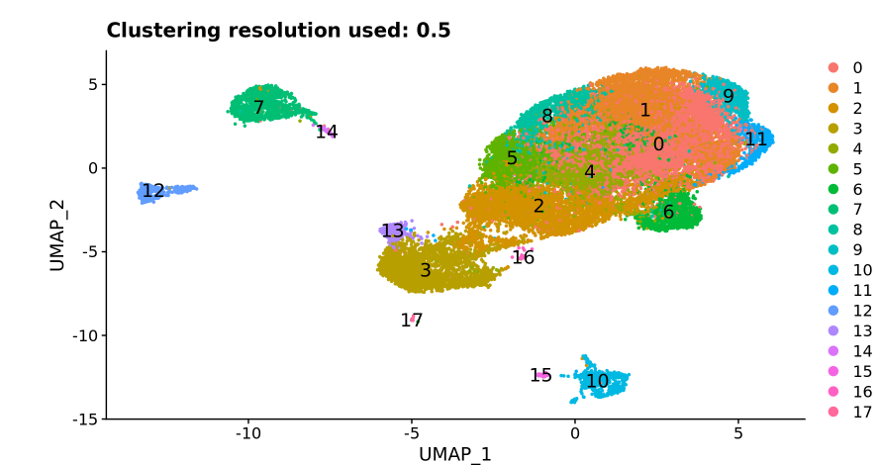
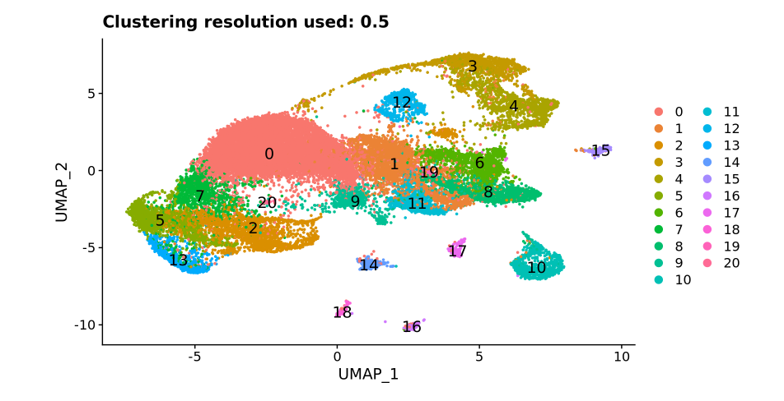
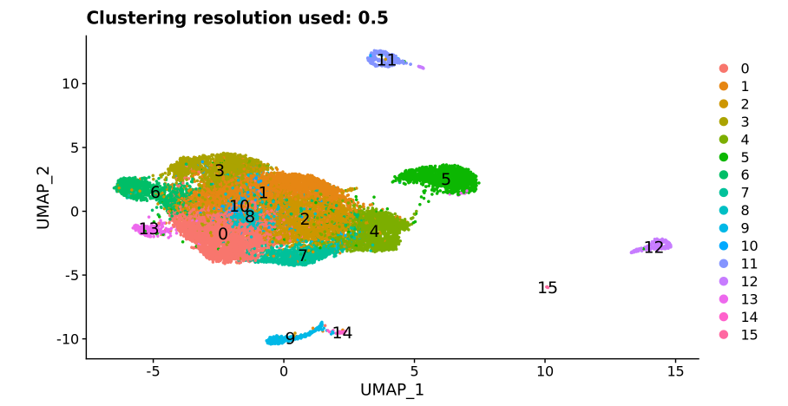
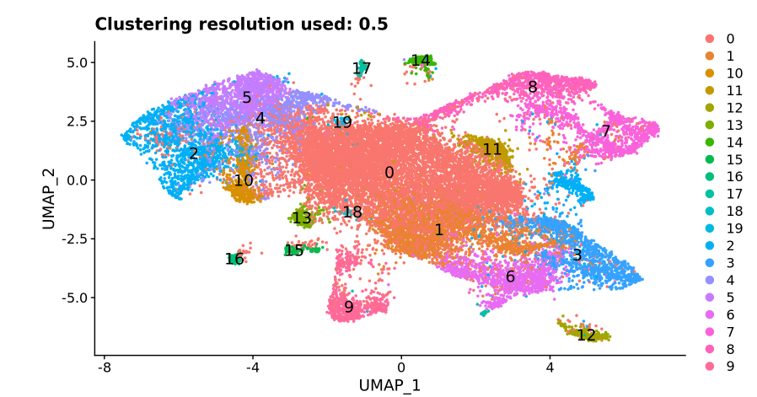
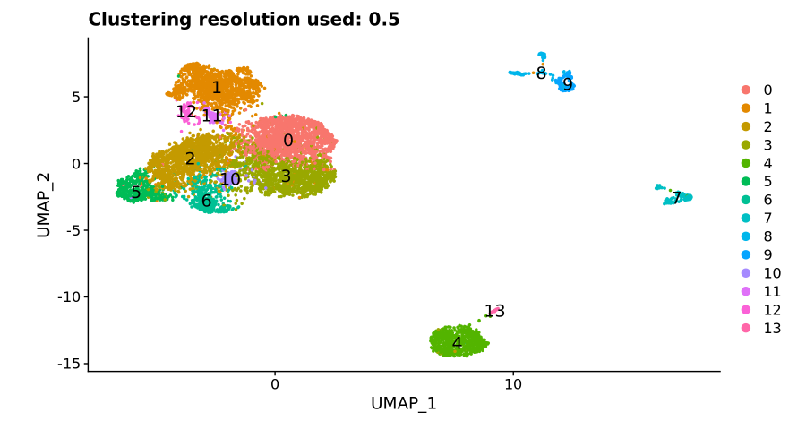
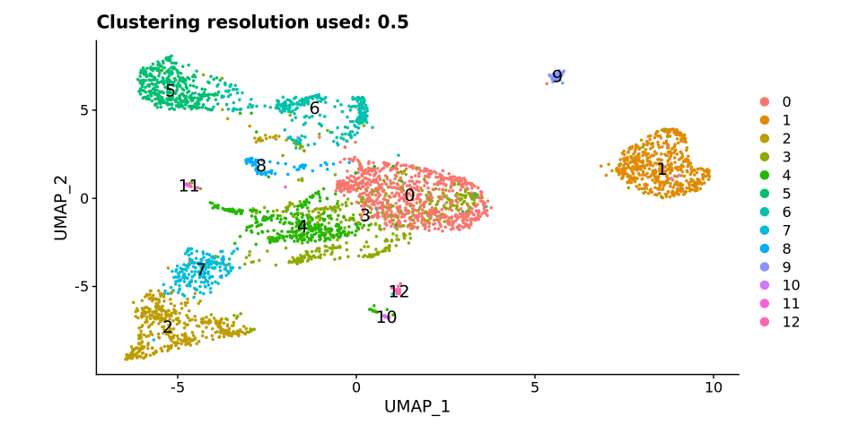
Overall Pattern
MIT
BGI
Complete
Control
Condition

